Slide 1
TensorFlow tutorial: Image classification using CNN
Soo Kim
Lawrence Livermore National Laboratories

Slide 2
Outline
Getting started: Graph and Session
CNN for MNIST classification
CNN for hurricane classification
Sources: Tensorflow for deep learning research: https://web.stanford.edu/class/cs20si/2017/
MNIST for ML Beginner: https://www.tensorflow.org/tutorials/

Slide 3
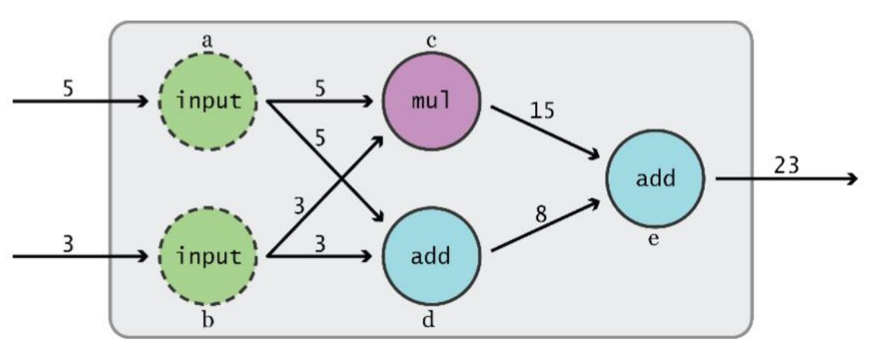
Data Flow Graphs
TensorFlow separates definition of computations from their execution
Phase 1: assemble a graph
Phase 2: use a session to execute operations in the graph.

Slide 4
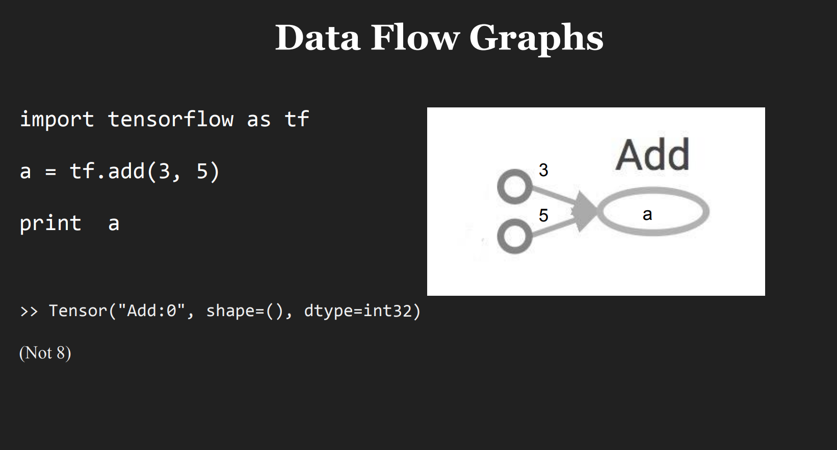

Slide 5
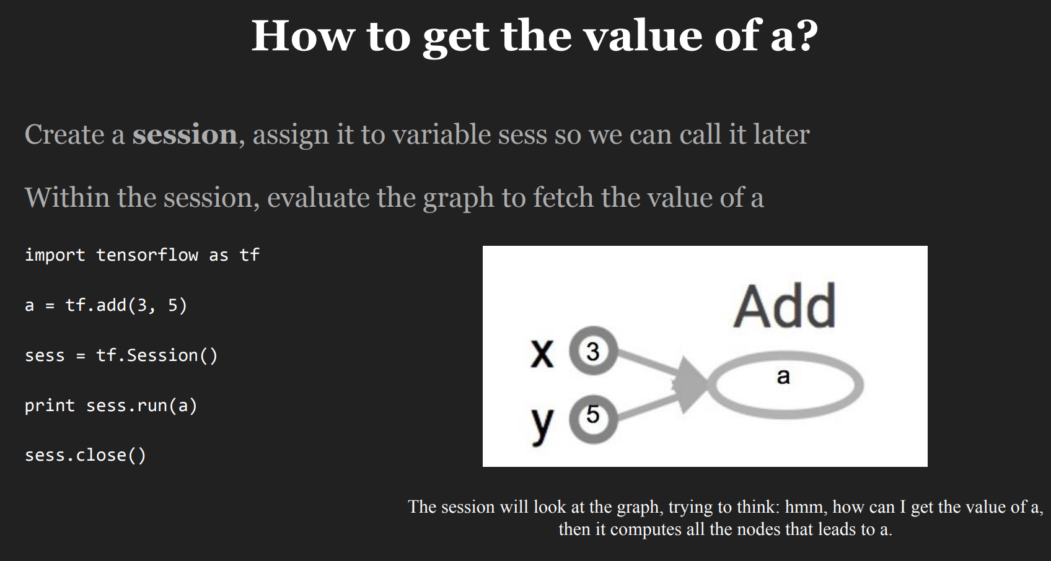
Notes:
세션은 텐서를 플로우 시킨후에 값을 출력한다.

Slide 6
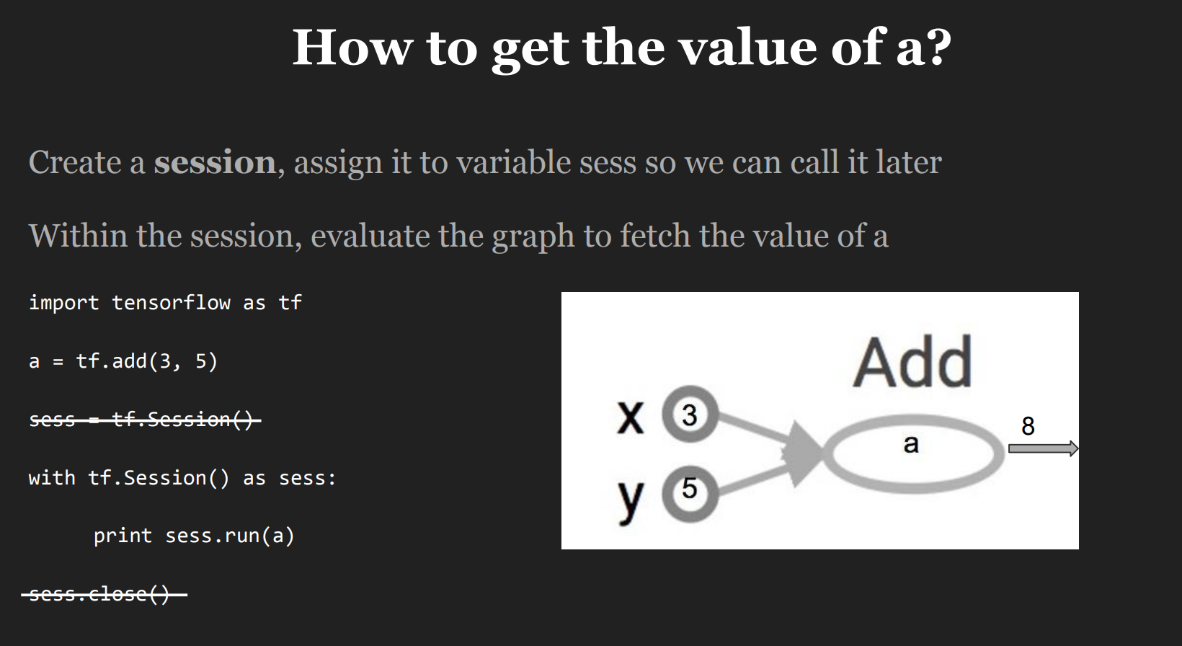
A Session object encapsulates the environment in which Operation objects are executed, and Tensor objects are evaluated.

Slide 7
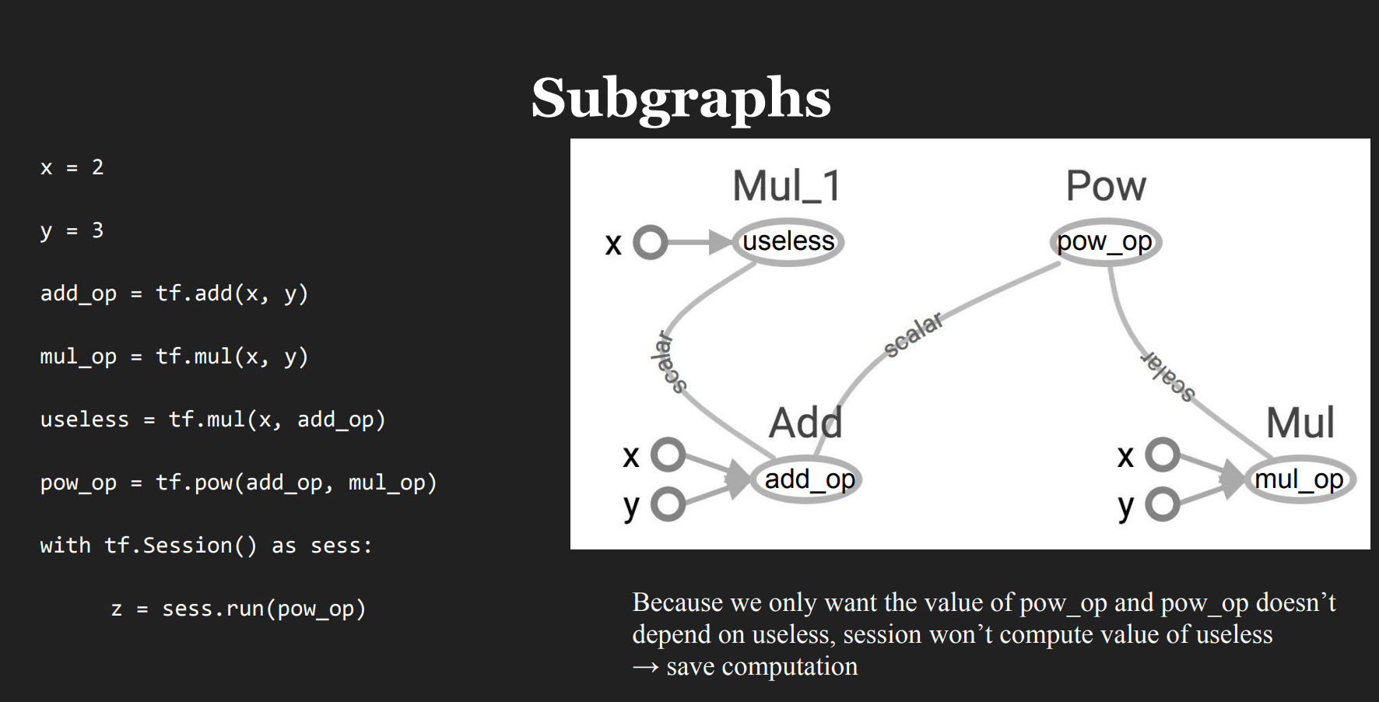

Slide 8
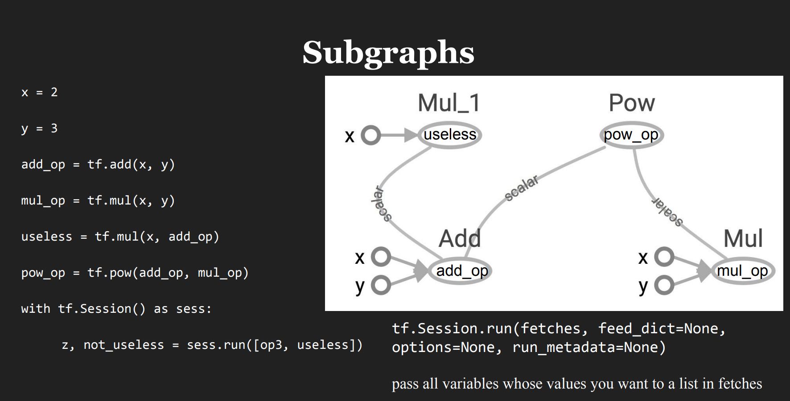

Slide 9
CNN for MNIST classification
https://github.com/aymericdamien/TensorFlow-Examples/blob/master/examples/3_NeuralNetworks/convolutional_network.py

Slide 10
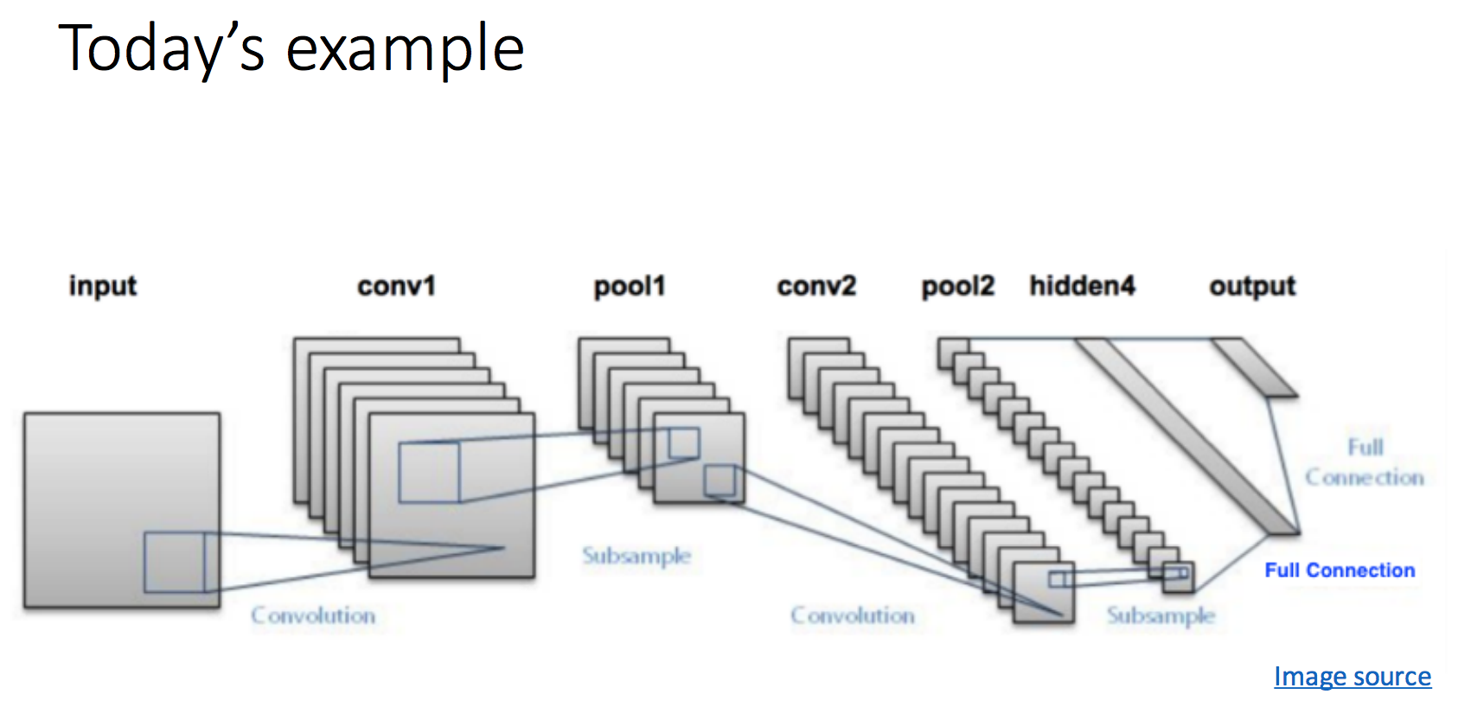
CNN for MNIST classification
https://github.com/aymericdamien/TensorFlow-Examples/blob/master/examples/3_NeuralNetworks/convolutional_network.py

Slide 11
Tensorflow implementation
Weight Initialization
Convolution and Pooling
Fully connected layer
Readout Layer
https://github.com/aymericdamien/TensorFlow-Examples/blob/master/examples/3_NeuralNetworks/convolutional_network.py

Slide 12
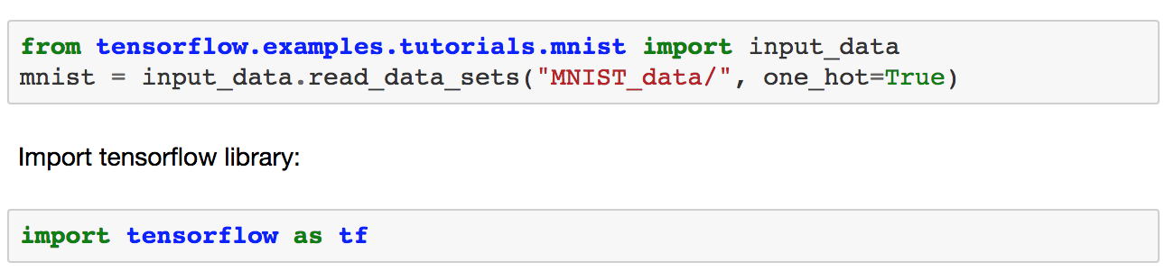
# Start TensorFlow Interactive Session
sess = tf.InteractiveSession()
https://github.com/aymericdamien/TensorFlow-Examples/blob/master/examples/3_NeuralNetworks/convolutional_network.py
Notes:
Difference btw tf.InteractiveSession() and tf.Session()
This allows to use interactive context, like shell, as it avoids having to pass an explicit Session object to run op:
sess = tf.InteractiveSession() a = tf.constant(5.0) b = tf.constant(6.0) c = a * b # We can just use 'c.eval()' without passing 'sess' print(c.eval()) sess.close() It is also possible to say, that InteractiveSession supports less typing, as allows to run variables without needing to constantly refer to the session object.

Slide 13
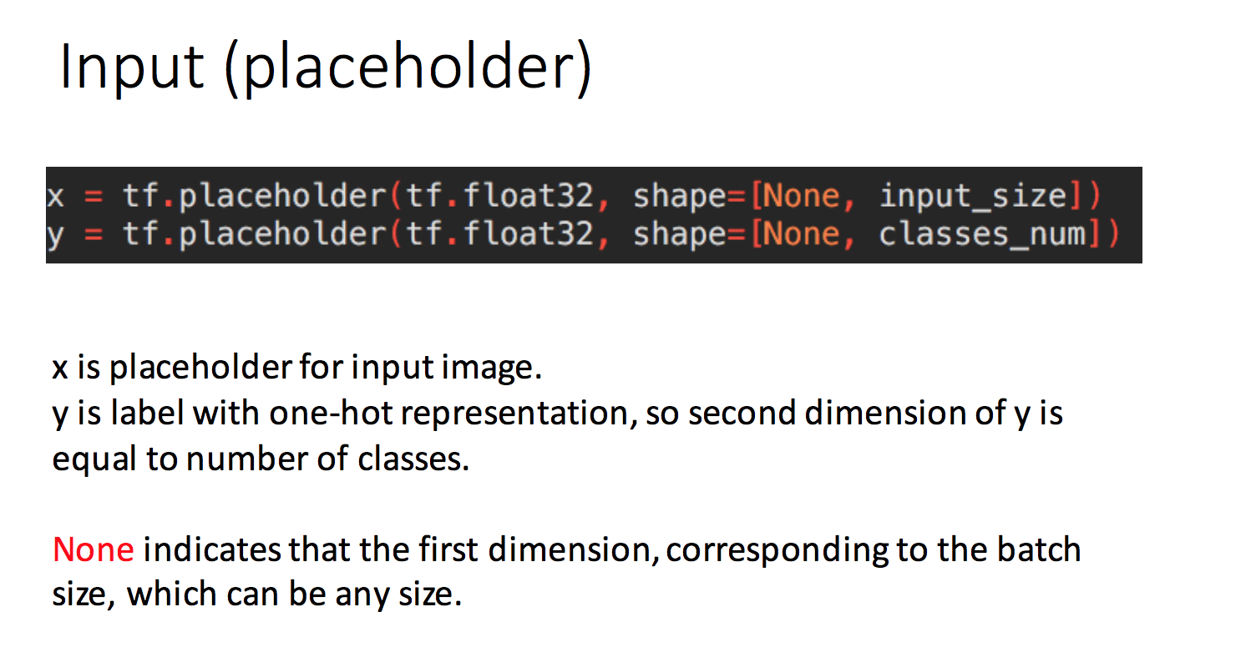
https://github.com/aymericdamien/TensorFlow-Examples/blob/master/examples/3_NeuralNetworks/convolutional_network.py
Notes:
x isn't a specific value. It's a placeholder, a value that we'll input when we ask TensorFlow to run a computation.
그래프에서 인풋을 넣을수 있는 어떠한 상자.
**placeholder is simply a variable that we will assign data to at a later date. It allows us to create our operations and build our computation graph, without needing the data.
We want to be able to input any number of MNIST images, each flattened into a 784-dimensional vector. We represent this as a 2-D tensor of floating-point numbers, with a shape [None, 784]. (Here None means that a dimension can be of any length.)

Slide 14
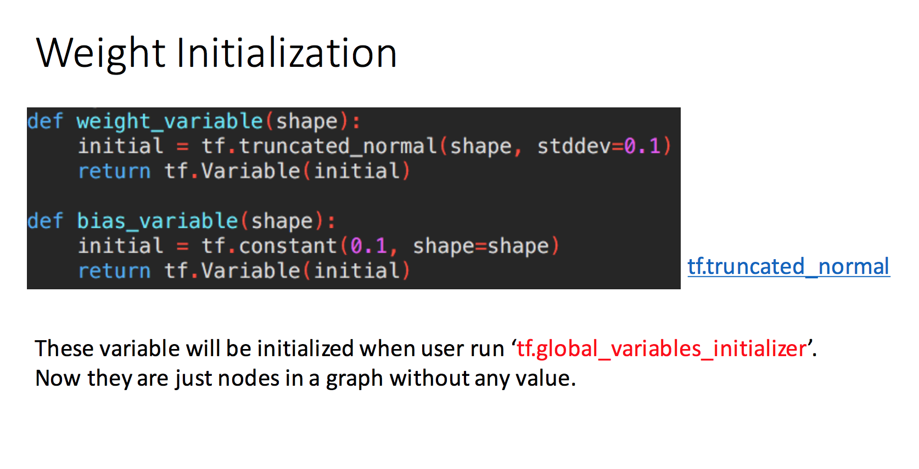
https://github.com/aymericdamien/TensorFlow-Examples/blob/master/examples/3_NeuralNetworks/convolutional_network.py
https://github.com/dguitarbite/deeplearningfun/blob/master/MNIST.py
Notes:
Tf.truncated_normal
Outputs random values from a truncated normal distribution.
The generated values follow a normal distribution with specified mean and standard deviation, except that values whose magnitude is more than 2 standard deviations from the mean are dropped and re-picked.
왜 노말 디스트리뷰션으로 이니셜라이즈 하나?
General ways to make it initialize better weights:
a) If you’re using ReLu activation function in the deep nets (I’m talking about the hidden layer’s output activation function) then:
Generate random sample of weights from a Gaussian distribution having mean 0 and a standard deviation of 1.
Multiply that sample with the square root of (2/ni). Where ni is number of input units for that layer.
왜 트런케이티드 디스트리뷰션으로 이니셜라이즈 하나?
The point for using truncated normal is to overcome saturation of tome functions like sigmoid (where if the value is too big/small, the neuron stops learning).

Slide 15
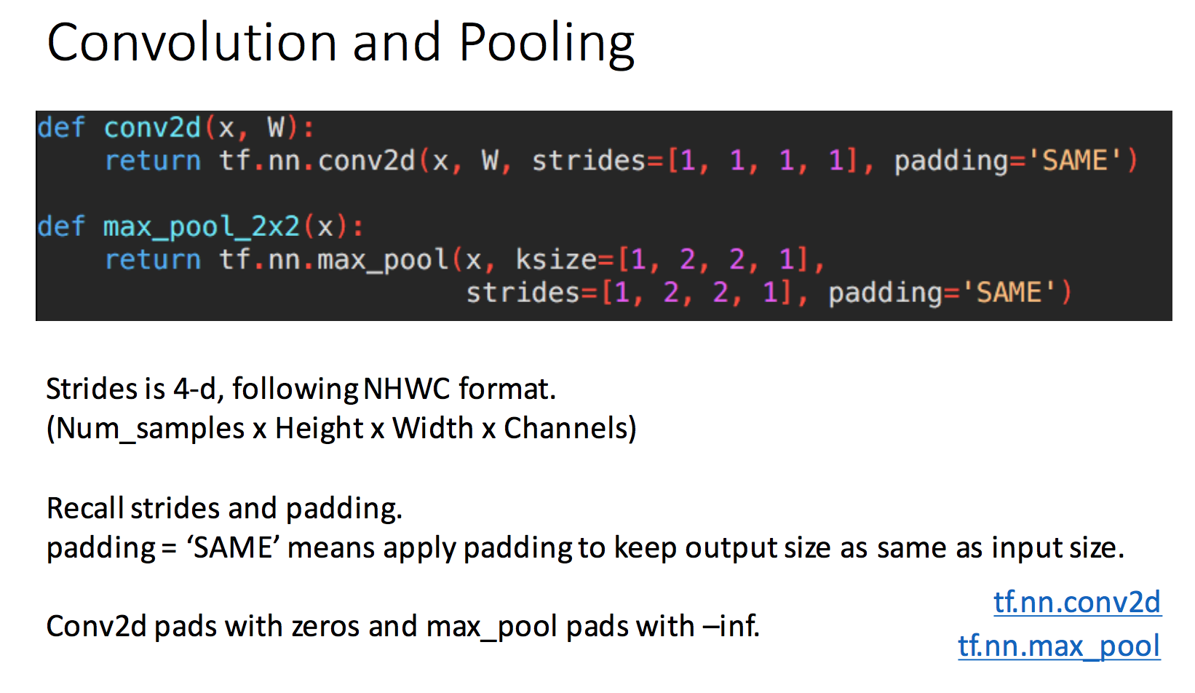
https://github.com/aymericdamien/TensorFlow-Examples/blob/master/examples/3_NeuralNetworks/convolutional_network.py
Notes:
https://www.tensorflow.org/api_docs/python/tf/nn/conv2d
Conv2d:
-Flattens the filter to a 2-D matrix with shape [filter_height * filter_width * in_channels, output_channels].
-Extracts image patches from the input tensor to form a virtual tensor of shape [batch, out_height, out_width, filter_height * filter_width * in_channels].
-For each patch, right-multiplies the filter matrix and the image patch vector.
https://www.tensorflow.org/versions/r1.0/api_docs/python/tf/nn/max_pool
value: A 4-D Tensor with shape [batch, height, width, channels] and type tf.float32.
ksize: A list of ints that has length >= 4. The size of the window for each dimension of the input tensor.
strides: A list of ints that has length >= 4. The stride of the sliding window for each dimension of the input tensor.
padding: A string, either 'VALID' or 'SAME'. The padding algorithm. See the comment here
data_format: A string. 'NHWC' and 'NCHW' are supported.
name: Optional name for the operation.

Slide 16
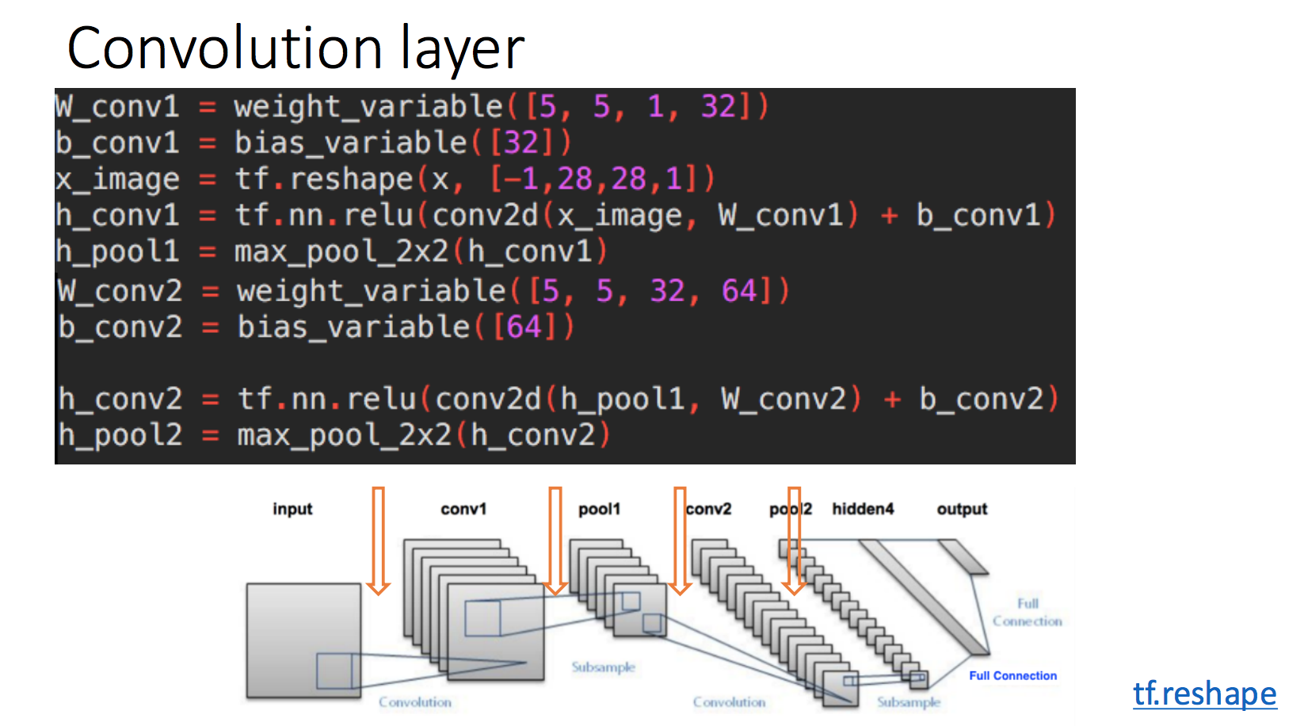
https://github.com/aymericdamien/TensorFlow-Examples/blob/master/examples/3_NeuralNetworks/convolutional_network.py

Slide 17
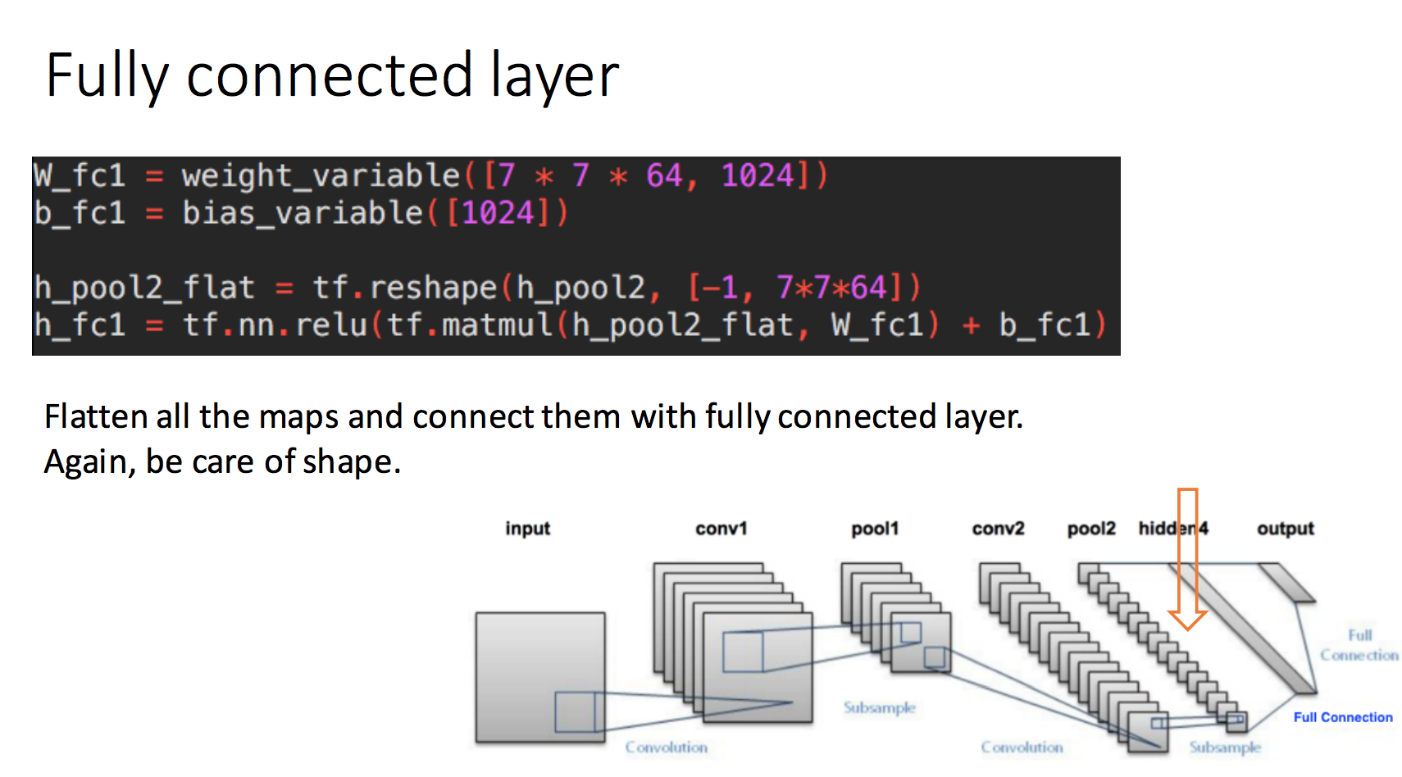
https://github.com/aymericdamien/TensorFlow-Examples/blob/master/examples/3_NeuralNetworks/convolutional_network.py

Slide 18
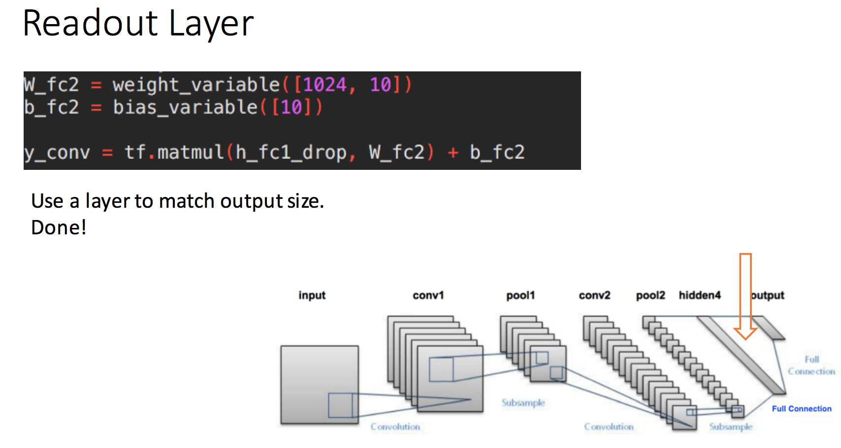
https://github.com/aymericdamien/TensorFlow-Examples/blob/master/examples/3_NeuralNetworks/convolutional_network.py

Slide 19
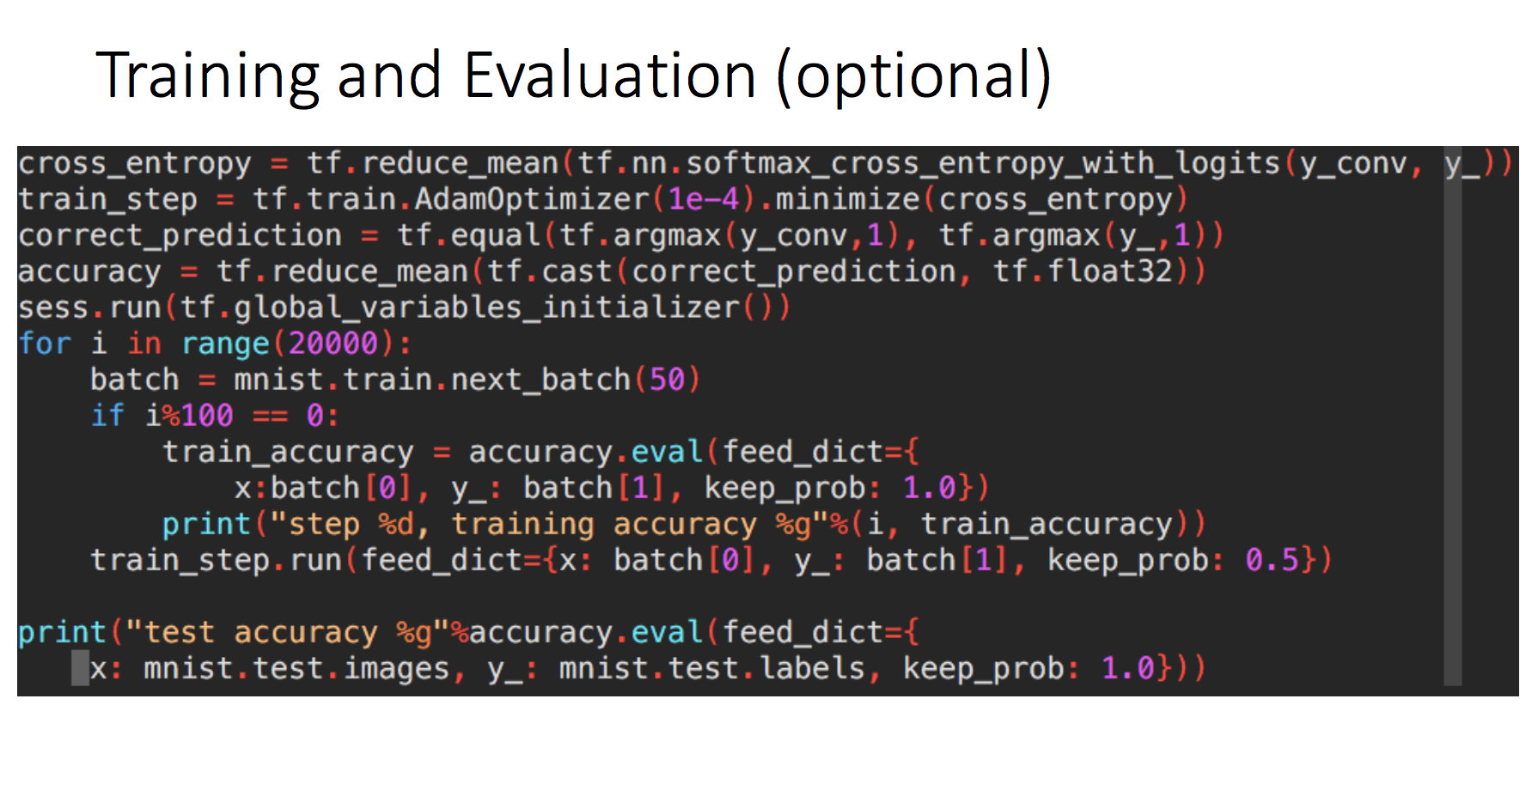
https://github.com/aymericdamien/TensorFlow-Examples/blob/master/examples/3_NeuralNetworks/convolutional_network.py
Notes:
(?)cross entropy between two probability distributions p and q measures the average number of bits needed to identify an event drawn from the set:
where p is the true distribution and q is the model distribution.
벳치로 트레이닝 하는 이유: (?)
In batch gradient descent, you compute the gradient over the entire dataset, averaging over potentially a vast amount of information. It takes lots of memory to do that. But the real handicap is the batch gradient trajectory land you in a bad spot (saddle point).
In pure SGD, on the other hand, you update your parameters by adding (minus sign) the gradient computed on a single instance of the dataset. Since it's based on one random data point, it's very noisy and may go off in a direction far from the batch gradient. However, the noisiness is exactly what you want in non-convex optimization, because it helps you escape from saddle points or local minima(Theorem 6 in [2]). The disadvantage is it's terribly inefficient and you need to loop over the entire dataset many times to find a good solution.
The minibatch methodology is a compromise that injects enough noise to each gradient update, while achieving a relative speedy convergence.

Slide 20
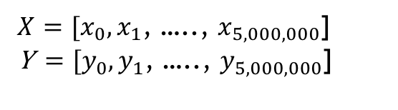
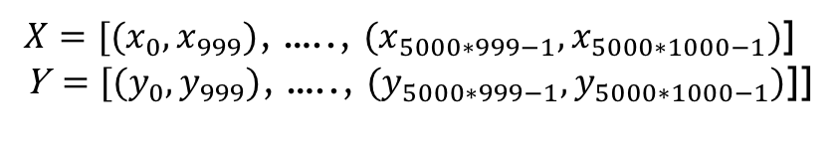
Batch vs Mini-batch gradient descent (optional)
1. Batch Gradient Descent
2. Mini-Batch Gradient Descent
$X=[x_{0},x_{1}$, ….., $x_{5,000,000}$] Y$=[y_{0},y_{1}$, ….., $y_{5,000,000}$]
$X=[{(x}_{0},x_{999})$, ….., ${(x}_{5000∗999−1},x_{5000∗1000−1})$] Y$=[{(y}_{0},y_{999})\text{, ….., }{(y}_{5000∗999−1},y_{5000∗1000−1})\text{]}$]
Train with (X,Y) for each epoch --> Memory intensive --> computing cost high
Train with ((x_{(i-1)*1000,} x_{i*1000}),(y_{(i-1)*1000,} y_{i*1000})) for each epoch batch-size=1000
Loss
Loss
Iterations
Iterations
Notes:
Batch vs Mini-batch gradient descent

